Slide 1



TranslaGenix
Making connections through communication

Slide 2
Introductions
Trainer: Pushpinder Kaur
Product Owner: Vladimir Shnyakin
Project Lead: Harsh Tamakuwala
SCRUM Master: Kevin Pilatzke
DevOps Team Lead: Daniel Oszczapinski
DevOps Team: Blake Anderson / Osman Elmahadi
Backend Team Lead: Sean Letts
Backend Team: Jermaine Williams / Marcos Fonseca
Frontend Team Lead: Leo Ware
Frontend Team: Gabriel Garcia / Briceson Roy / Edith Kennedy-Tynes
Randy Robinson / Steve Burgos / Jamaal Fisher

Slide 3
Translagenix:
A single page application
Designed to help with communication despite language barrier
Has a learning component
Has a gaming and competitive element
Simple but powerful due to use of external API’s
Easily accessible but secure

Slide 4




Communication
Benefits of Asynchronous Work & Communication:
Discord
Zoom
Trello
Github

Slide 5
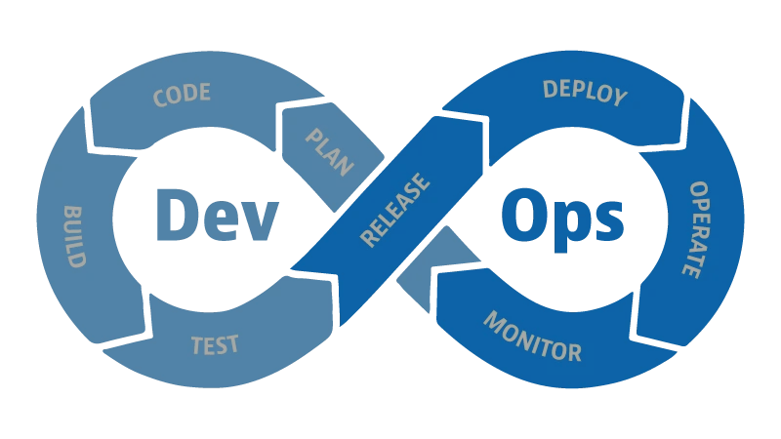
Lead: Daniel Oszczapinski
Blake Anderson, Osman Elmahadi

Slide 6




Overview
•GitHub
•GitHub Actions
•Docker
•Microsoft Azure
•Managed any merge conflicts
•helped with Git issues

Slide 7

CI/CD Pipeline Explanation
•Continuous Integration:
•Is the process of automating the building and testing of an application after each incremental and functional change to the code base.
•Continuous Delivery – Manual process during the pull requests
•Continuous Deployment:
•any new code updates or changes that makes it through the rigorous automated test process is deployed directly into the live production environment where it will be visible to customers.

Slide 8

Backend – CI/CD Pipeline
Pull Request(CI)
•Implemented SonarCloud
•Unit Test Coverage
•Built and Analyzed for vulnerabilities using Sonar cloud
Push to main(CI/CD)
•Login, Build and push to Docker
•Deploy Azure using Docker Container
•Environment variables – connection string in Azure

Slide 9

Frontend - Deployment
•Good git practices for less merge conflicts and committing often
•Manually Deployment on Azure using Azure App Services Extension

Slide 10
Backend
Sean Letts, Jermaine Williams & Marcos Fonseca

Slide 11

Entity Framework
Code first approach
Marked Variables as unique within C#
Did some manual edits to databases within SQL
Whenever a new object is created (User, Point, Words, etc) the id is automatically created
Added the migration commands as comments at the bottom of the DbContext file
Notes:
Sean

Slide 12
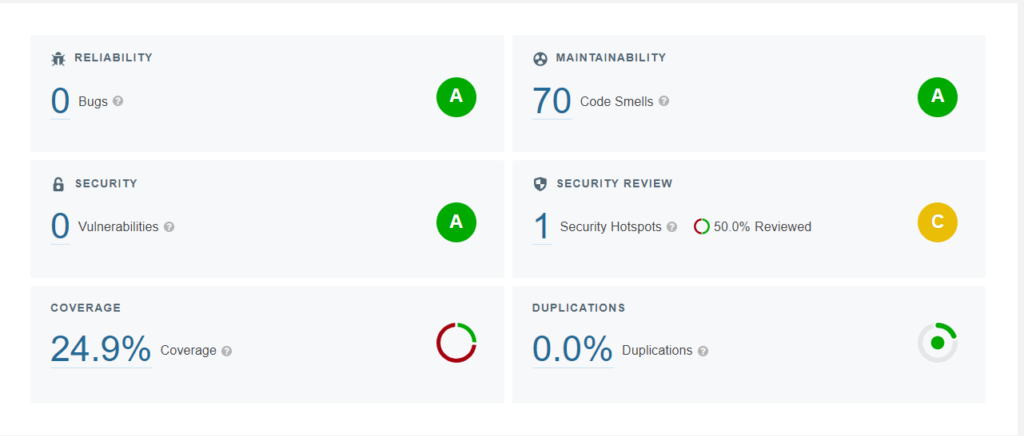
SonarCloud
Notes:
Marcos

Slide 13


Tests
We used xUnit testing tool
Moq library that allows us to create mock objects in test code.
Notes:
Marcos

Slide 14
Controllers
Variety of controllers for different functions of the app.
Ex. Get All Users by Firstname/Username/Email
Had to refine/alter the methods to make compatible with Okta
Testing covers the controllers the most
Try Catch blocks for preventing crashes
Notes:
Jermaine

Slide 15
Frontend
Lead: Leo Ware
Steve Burgos, Jamaal Fisher, Edith Kennedy-Tynes, Gabriel Garcia, Randy Robinson, Briceson Roy
Notes:
Leo

Slide 16
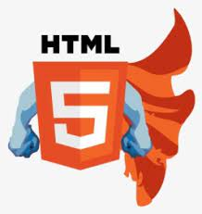



Accessible
Responsive
Interactive
Notes:
Leo Ware ** Kevin, click the screen once for “Accessible” to appear. Click once more for “Responsive” to appear. And one last click should bring “Interactive” in from the left.
DON’T STEAL MY STEAZE Jk. If you need the logo, use it.

Slide 17
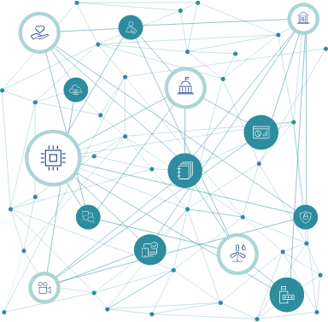

Okta Login and Registration
Okta is an identity access management service provider. It provides cloud software, that allows companies manage and secure user authentication into applications.
Okta has built in database management, or you can still manage your own.
Make the ‘stack’ of your Choice work better for you.
Notes:
Gabriel and Randy

Slide 18
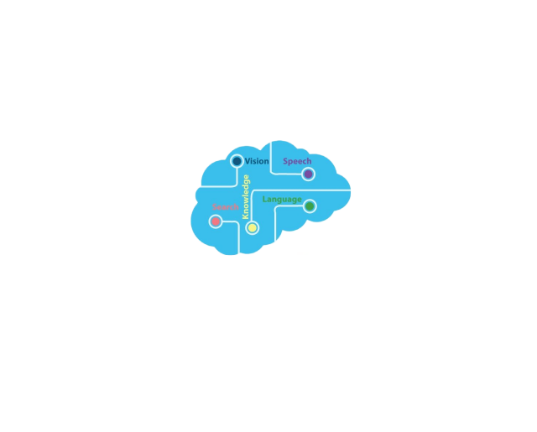
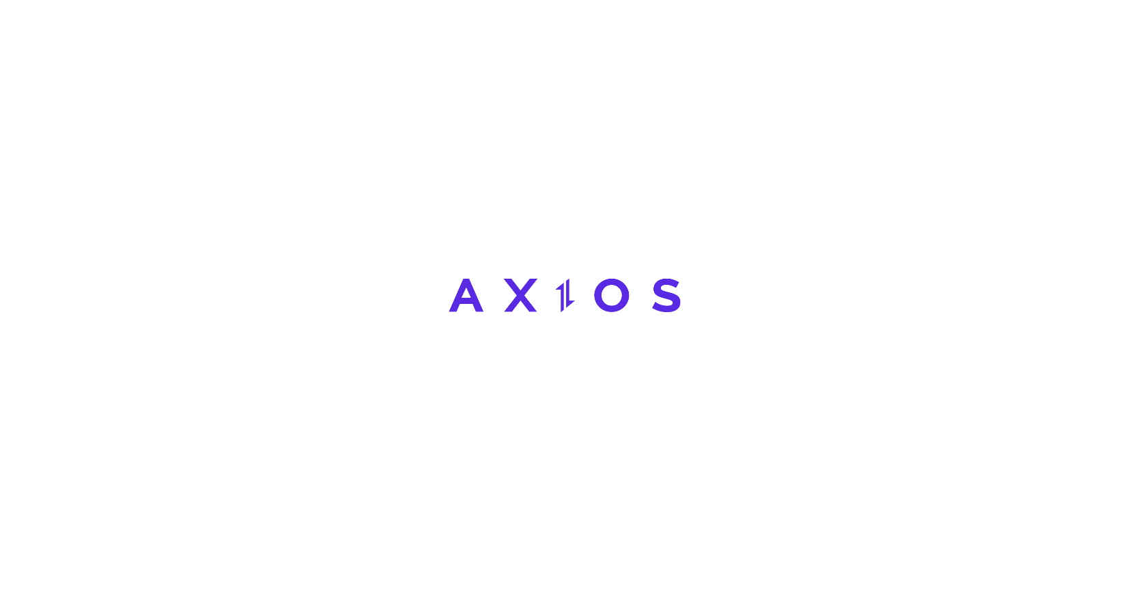



Speech to Text
An easy way to convert speech to text and translate that text
Important Technology
Axios
Angular
Annyang Speech Recognition Library
Azure Cognitive Services Translator
Notes:
Steve

Slide 19
Learning Words
A text-to-speech functionality where users are given a random word or phrase to learn in another language.
Important Technology
Axios
Angular
Annyang Speech Recognition Library
Azure Cognitive Services Translator
Notes:
Jamaal

Slide 20

Leaderboard
Used Kiran Workspace to research user friendly layouts and designs
Implemented CSS, SASS, HTML5 and Typescript to implement interactive and responsive design
Notes:
Edith Kennedy-Tynes

Slide 21

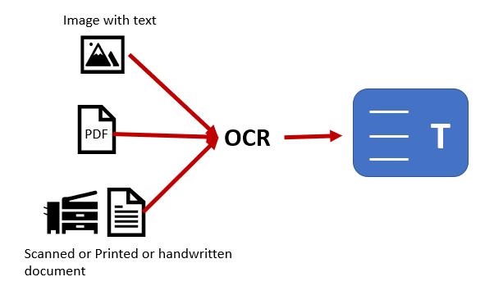
File OCR
To get the text from an image a file ocr API was implemented.
We could get text from both files and urls and transcribe the text from them
Bare in mind that the API is on free tier so certain formats won’t work with it.
Note: Use only jpg and png format files and image links since those are the most stable.
Notes:
Briceson

Slide 22
We will now demonstrate!

Slide 23
Conclusion
Special thanks to:
Our trainer - Pushpinder Kaur
QC team and Jon Infante
Fred Belotte
Nick Escalona
Bryan Serfozo
Juniper Song
Notes:
Eyyyyyyyyyy Lmao based What in the world??? Don’t worry about it CHAOS ENTROPY I’m doing the conclusion, dude
It’s my outro
I’m literally just rolling the credits A NEVER ENDING CYCLE Yes but I’m causing chaos Son of a biscuit
I like biscuits

Slide 24
Q and A
Notes:
The FitnessGram PACER Test is a multistage aerobic capacity test that progressively gets more difficult as it continues.
The test is used to measure a student's aerobic capacity as part of the FitnessGram assessment. Students run back and forth as many times as they can, each lap signaled by a beep sound. The test get progressively faster as it continues until the student reaches their max lap score.
The PACER Test score is combined in the FitnessGram software with scores for muscular strength, endurance, flexibility and body composition to determine whether a student is in the Healthy Fitness Zone™ or the Needs Improvement Zone™.

